Slide 1
MAT104: Mathematics for Elementary Education
OER Seminar Project
May 13, 2020
Spring 1, 2020

Slide 2
About MAT104
Catalog Description: This is the second course of a two-semester sequence devoted to the study of how children learn mathematics. Among the topics included are operations on rational numbers, geometry and measurement, and basic notions of statistics of particular value to prospective school teachers and paraprofessionals.
This course is designed for those studying to become elementary school teachers. The course examines the mathematics curriculum of the elementary school with an emphasis on how to teach it.

Slide 3
About MAT104
Needed to be updated due to changes in NYS Math Curriculum Standards
Currently taught through Lumen
Adopting the Lumen platform in order to use OER textbooks and material available in such platform

Slide 4
Textbooks
Not a lot of textbooks available that address this particular class or NYS standards
The Lumen class came packaged with notes that were made available by Julie Harland and James Sousa (CK-12.org)
A textbook recently created from the University of Hawaii
Mathematics for Elementary Teachers by Michelle Maines

Slide 5
Textbooks

Slide 6
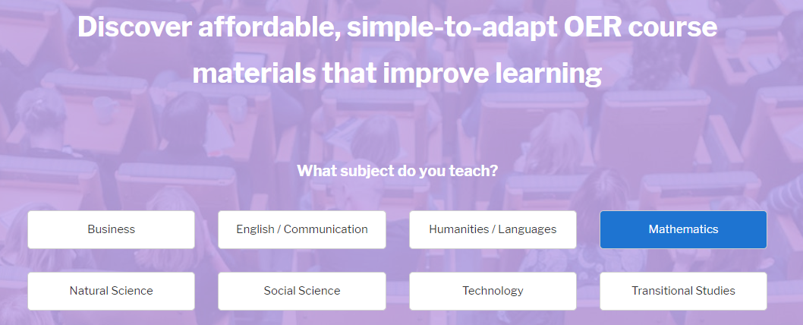
OER Course Material
(Excellent source for this project)
https://lumenlearning.com/courses/

Slide 7
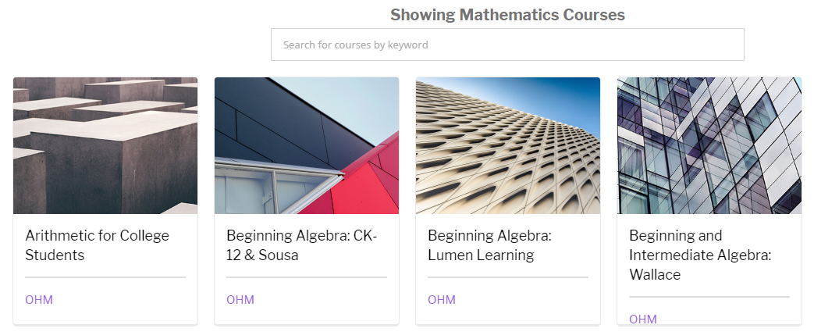
OER Course Material

Slide 8
Units/Modules Content Structure
In Lumen, each unit contains:
A link to the appropriate textbook sections
Links to videos
Video assignment
Homework Assignment

Slide 9
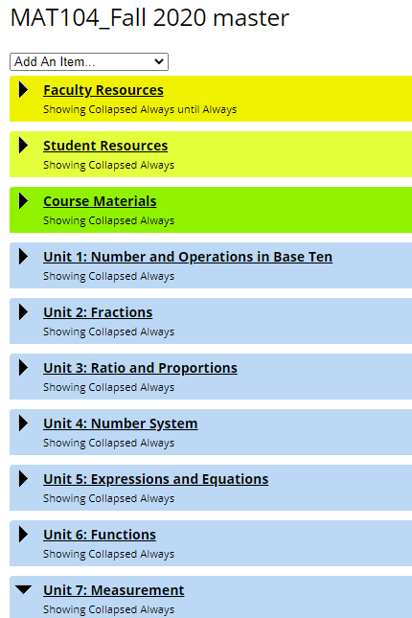
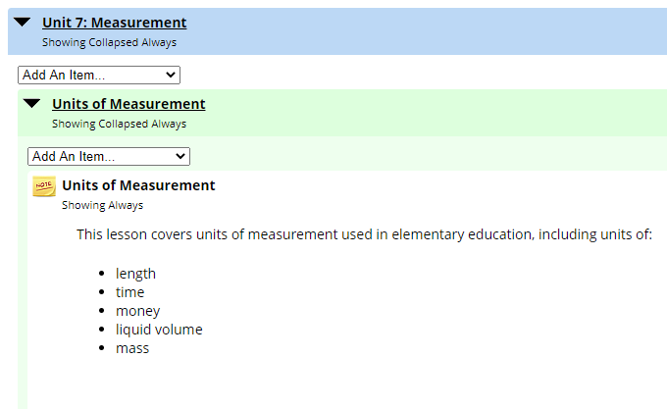
Units/Modules Content Structure

Slide 10
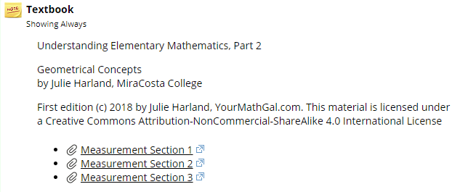
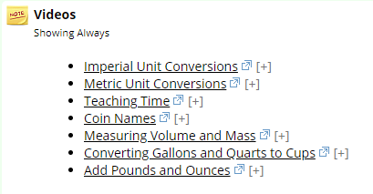
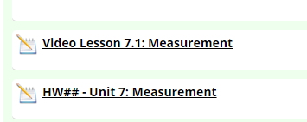
Units/Modules Content Structure

Slide 11
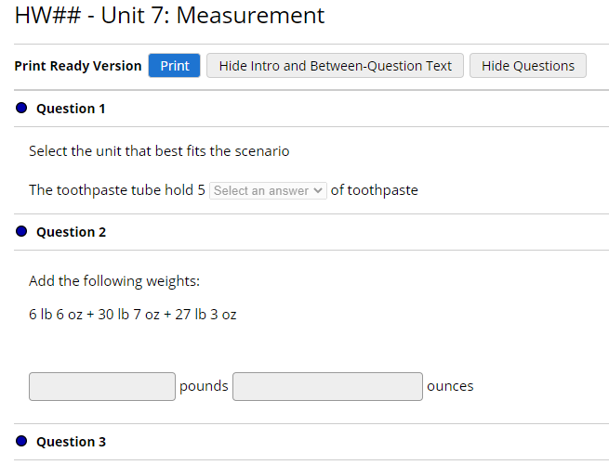
Units/Modules Content Structure

Slide 12
Summary/Questions

